Slide 1
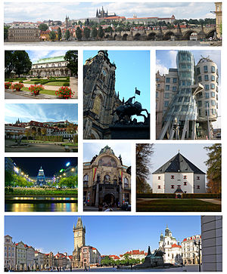
Prague

Slide 2
About Prague:
Is the capital and largest of the Czech Republic. It is the fourteenth-largest city in the European union.
Situated in the north-west of the country on the Vltava river, the city is home to about 1.3 million people, while it is larger urban zone is estimated to have a population of nearly 2 million.
Prague was not only the capital of the Czech state, but also the seat of two Holy Roman Emperors and thus also the capital of the Holy Roman Empire. It was an important city to the Habsburg Monarchy and its Austro-Hungarian Empire and after World War I became the capital of Czechoslovakia.

Slide 3
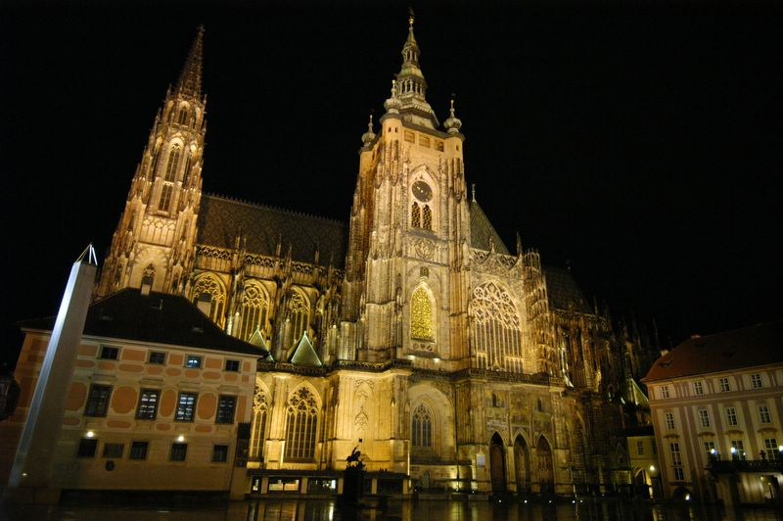
Prague Castle
Castle in Prague where the Czech presidents have their offices
The Crown Jewels are kept within a hidden room inside it.
Castle is the biggest castle in the world
570 metres in length and an average of about 130 metres wide.

Slide 4
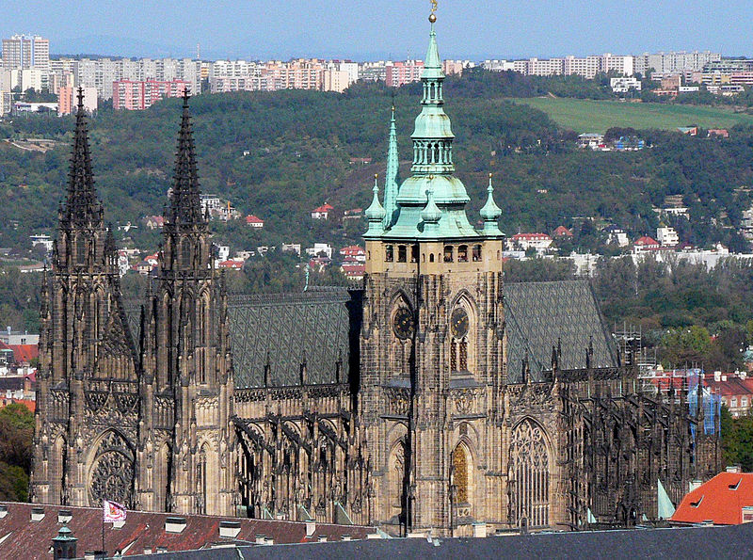
St. Vitus Cathedral
is a Roman Catholic cathedral in Prague, and the seat of the Archbishop of Prague. The full name of the cathedral is St. Vitus, St. Wenceslas and St. Adalbert Cathedral.
This cathedral is an excellent example of Gothic architecture and is the biggest and most important church in the country.

Slide 5
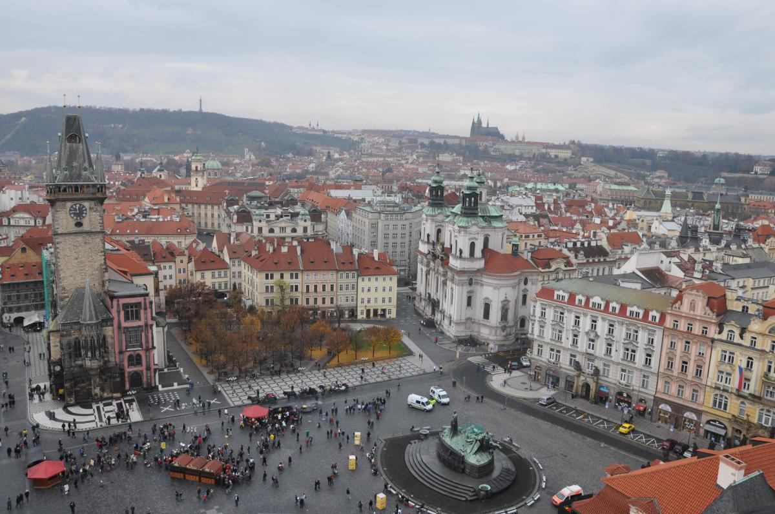
Old town square
Located between Wenceslas Square and the Charles Bridge, Prague's Old Town Square is often bursting at the seams with tourists in the summer.
The square is an oasis for travelers wearied by Prague's narrow streets. Among many churches, tourists may find the Astronomical Clock on this square, while the tower at the Old Town Hall offers a panoramic view of Old Town shop.

Slide 6
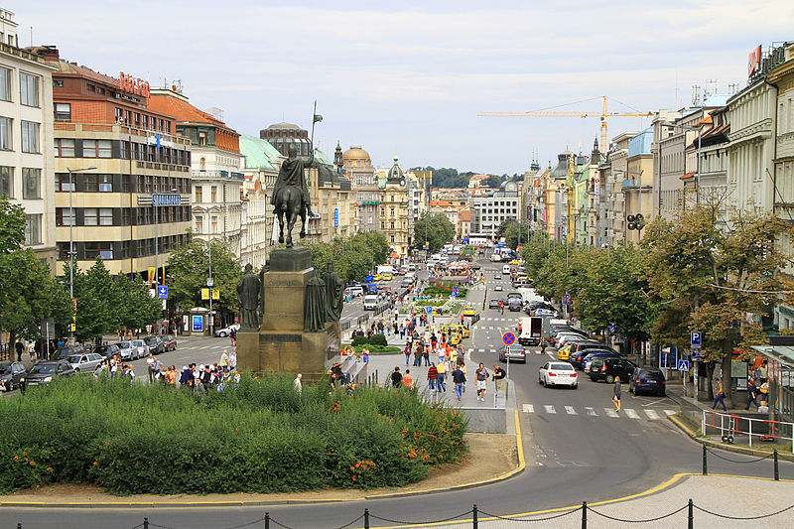
Wenceslas square
Is one of the main city squares and the centre of the business and cultural communities in the New Town.
Many historical events occurred there, and it is a traditional setting for demonstrations, celebrations, and other public gatherings.
The square is named after Saint Wenceslas, the patron saint of Bohemia.

Slide 7
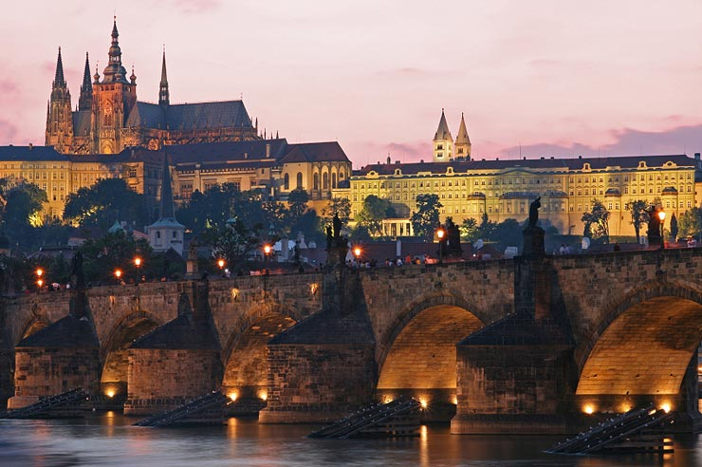
Charles bridge
Is a famous historic bridge that crosses the Vltava river.
It is construction started in 1357 under the auspices of King Charles IV, and finished in the beginning of the 15th century.

Slide 8
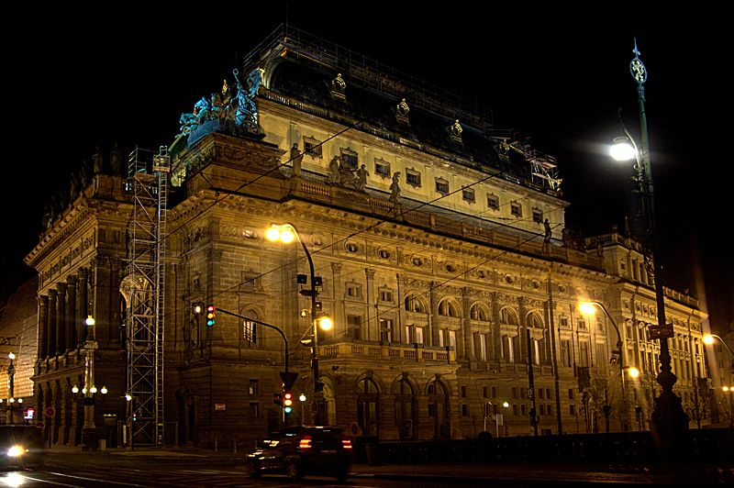
National theatre
Is known as the Alma Mater of Czech opera, and as the national monument of Czech history and art.
The National Theatre belongs to the most important Czech cultural institutions, with a rich artistic tradition which was created and maintained by the most distinguished personalities in Czech society.

Slide 9
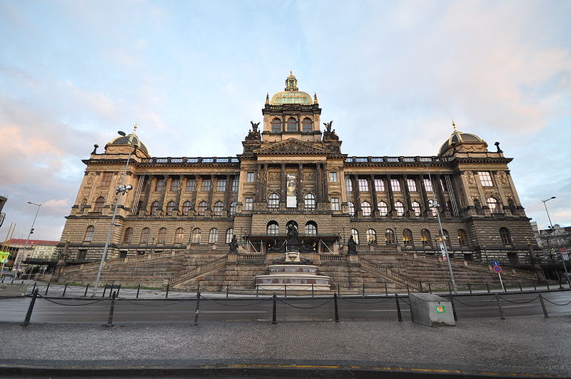
National Museum
Is a Czech museum institution intended to systematically establish, prepare and publicly exhibit natural scientific and historical collections.
At present the National Museum houses almost 14 million items from the area of natural history, history, arts, music and librarianship, located in tens of buildings.

Slide 10
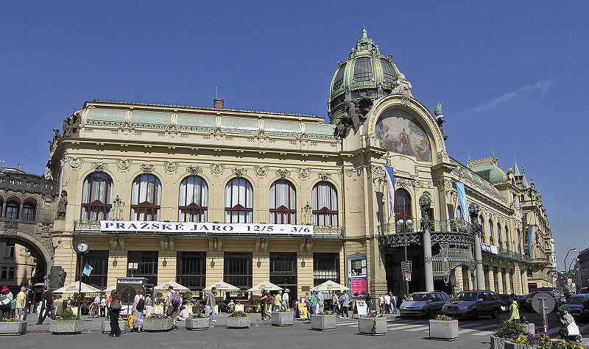
Municipal House
Is a major civic landmark and concert hall in Prague, and an important building in architectural and political history in the Czech Republic.

Slide 11
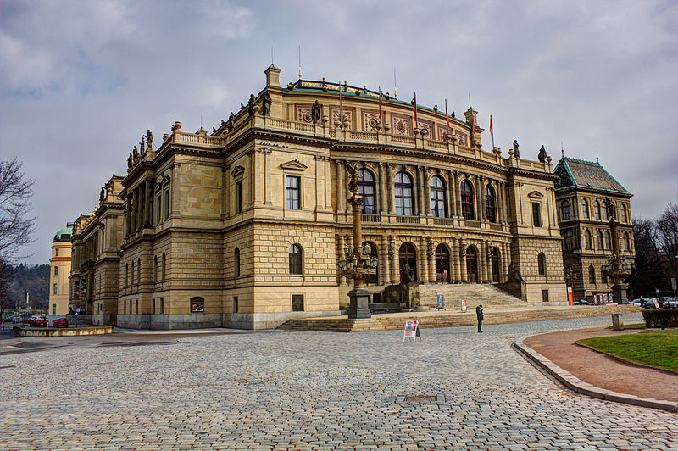
rudolfinum
The Rudolfinum is a music auditorium.
It is designed in the neo-renaissance style and is situated on Jan Palach Square on the bank of the river Vltava.

Slide 12
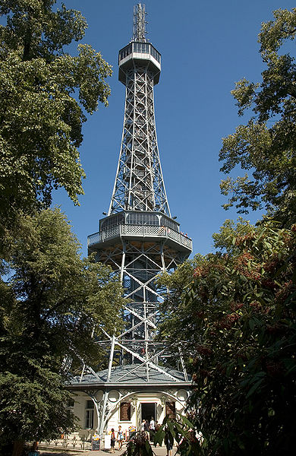
Petřín Lookout Tower
Is a 63.5 metre high steel framework tower which strongly resembles the Eiffel Tower.
Although it is much shorter than the Eiffel Tower, it stands atop a sizable hill, Petřín, so the top is actually at a higher altitude than that of the Eiffel Tower.

Slide 13
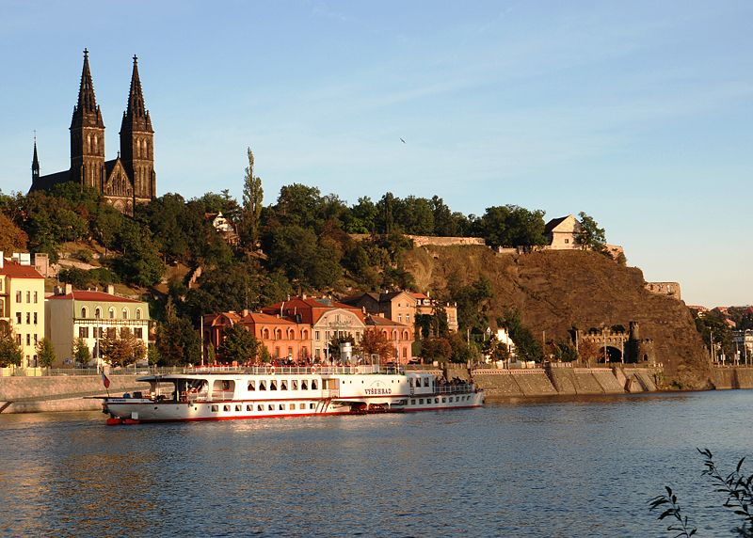
vyšehrad
Is a historical fort.
It was probably built in the 10th century, on a hill over the Vltava River.

Slide 14
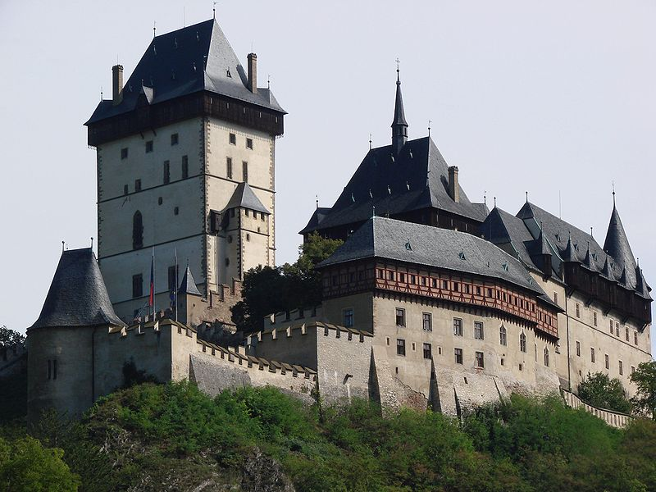
Karlštejn castle
Is a large Gothic castle founded 1348 by Charles IV.
The castle served as a place for safekeeping the Imperial Regalia as well as the Bohemian/Czech crown jewels, holy relics, and other royal treasures.

Slide 15
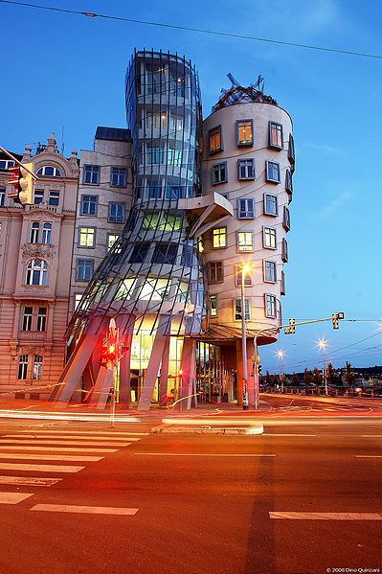
Dancing house
It was designed by the Croatian-Czech architect Vlado Milunić in co-operation with the renowned Canadian-American architect Frank Gehry on a vacant riverfront plot.

Slide 16
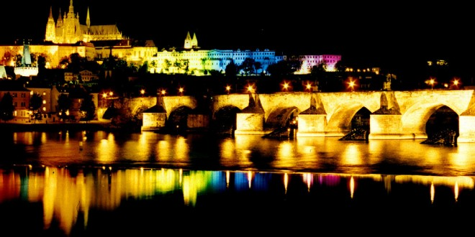
Author: Lucie konečná

